Slide 1
Rethinking Cybersecurity in the Quantum Age
Jerod Brennen
Founder & Principal Consultant, Brennen Consulting

Slide 2
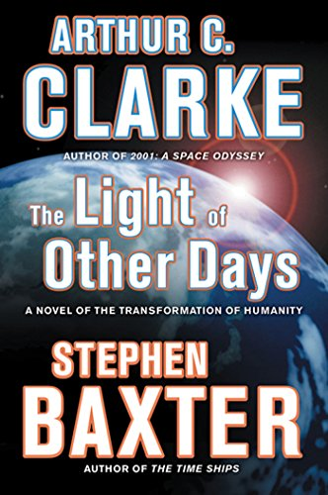

Oh, boy…

Slide 3
Digital computing -> quantum computing
Digital computing is based on bits
(0s and 1s)
Digital = 4 separate calculations
Quantum computing is based on qubits
(0s and 1s AND any combination of 0 & 1)
Quantum = 4 simultaneous calculations
[00, 01, 10, 11]
Superposition: the ability of a particle to be in several different states at the same time.
Entanglement: the ability of two particles to share information even at a distance.
Notes:
Qubit can be a photon, nucleus, or electron
Spin up vs. spin down (align with magnetic fields) -> classical 1 or 0
Before you measure, superposition, probability of being in a particular state when you measure it

Slide 4
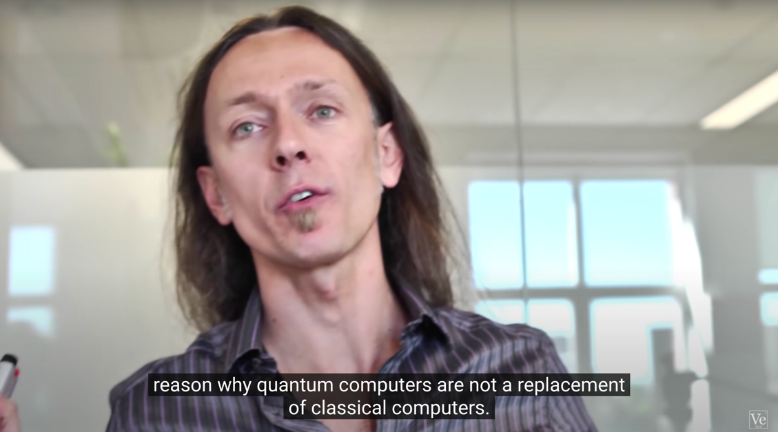
How Does a Quantum Computer Work? (from Veritasium)
https://www.youtube.com/watch?v=g_IaVepNDT4

Slide 5
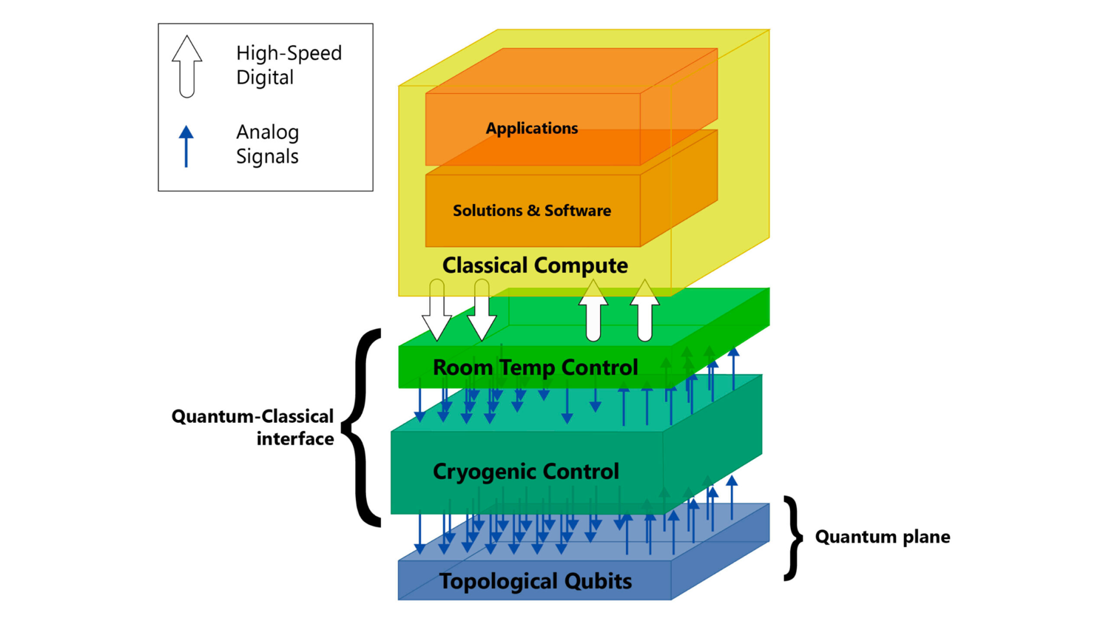
Image from https://www.microsoft.com/en-us/research/blog/full-stack-ahead-pioneering-quantum-hardware-allows-for-controlling-up-to-thousands-of-qubits-at-cryogenic-temperatures/

Slide 6
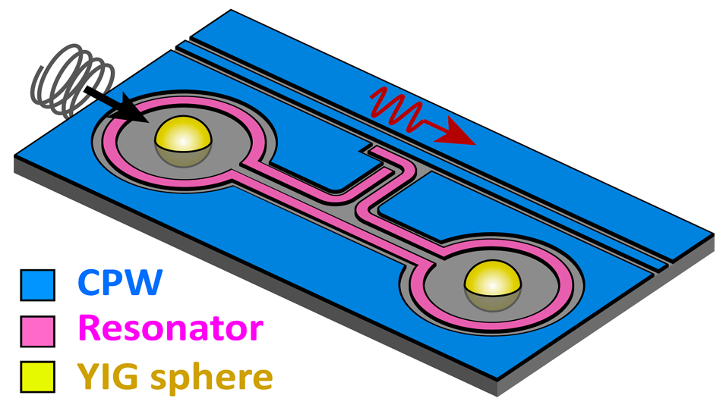
Magnets!
The “observer effect”
Magnets can be less expensive than cryogenic controls
Image from https://scitechdaily.com/tiny-magnets-could-hold-the-secret-to-miniaturizable-quantum-computers/

Slide 7
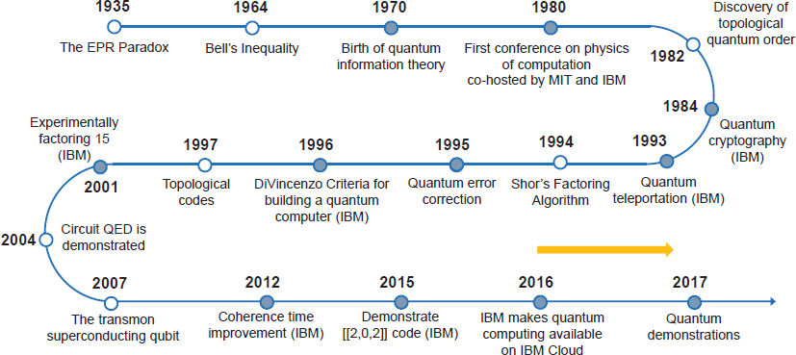
Image from https://devopedia.org/quantum-computing
Notes:
1980 - computation as physics
[1982]
1985 - universal quantum computer (think Quantum Turing Machine)
1992 - first quantum algorithm (1 vs. many)
[1994] - factoring can be done exponentially faster (not yet practical)
[1995]

Slide 8
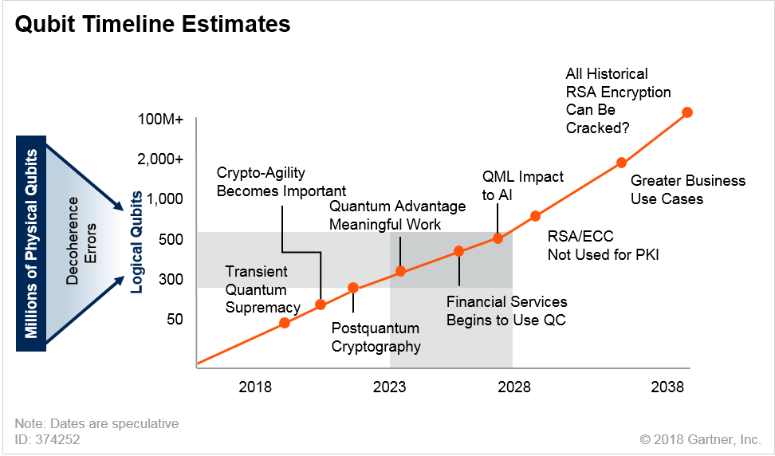
Image from https://www.futuretimeline.net/blog/2019/10/24.htm

Slide 9
“Industries like finance may begin to realize gains from quantum computing by 2025. ”
McKinsey & Company
Notes:
Est. 2k-5k quantum computers globally by 2030, mass adoption by 2035.
Also, The worldwide market for quantum computing is predicted to be more than USD 10 billion by 2024, and USD 65 billion by 2030.
https://www.ibm.com/thought-leadership/institute-business-value/report/quantumsecurity
https://www.ibm.com/blogs/industries/quantum-computing-cybersecurity-risks-quantum-safe-cryptography/

Slide 10
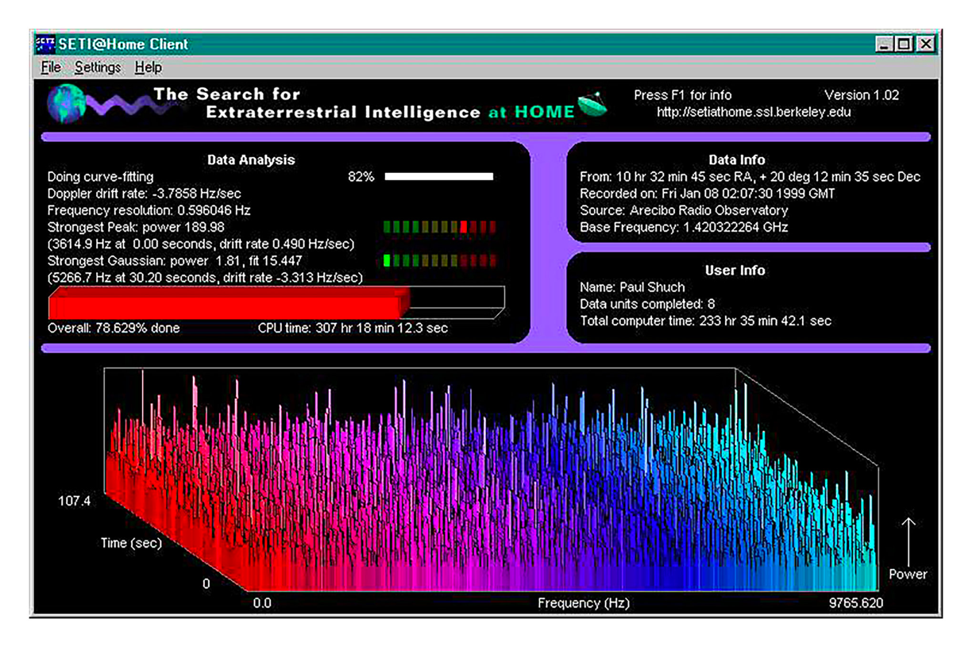

Slide 11
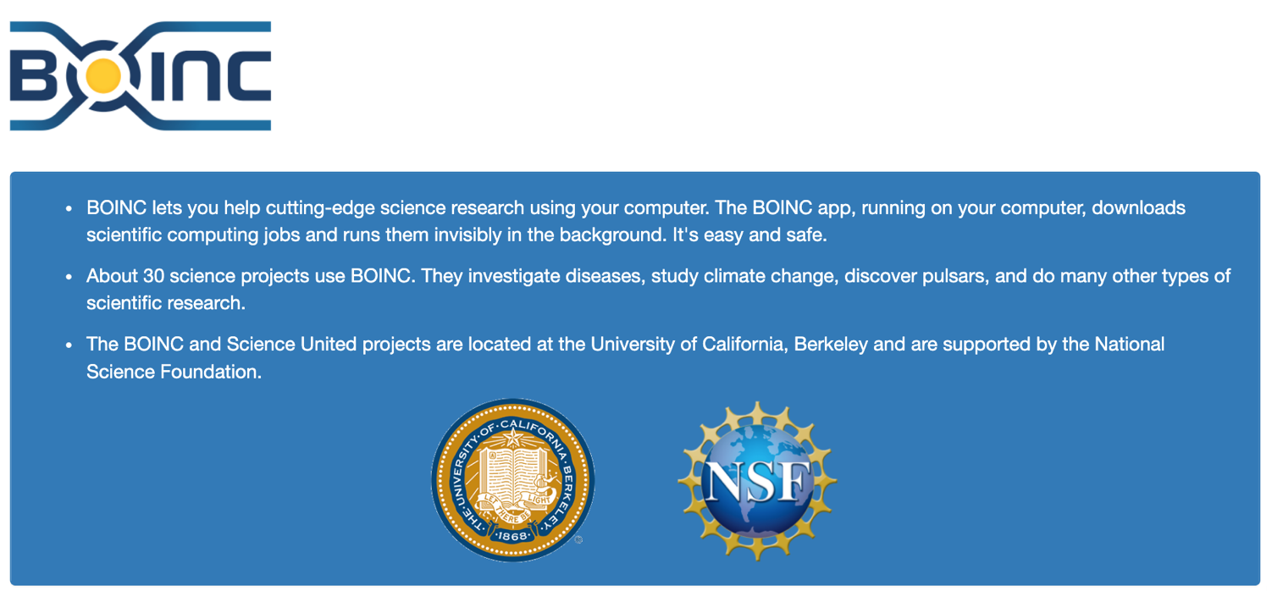
https://boinc.berkeley.edu/

Slide 12

Cryptography relies on random number generation
PKI relies on secure key exchange mechanisms
GSM cellular standard relies on symmetric encryption
Notes:
GSM is popular for IoT

Slide 13
Quantum decryption proof of concept
Google + KTH Royal Institute of Tech (Stockholm)
Through a clever implementation of quantum technology (modular exponentiation), the team demonstrated in 2019 that a 20-million-qubit quantum computer can break a 2048-bit number in 8 hours.
By comparison, “It would take a classical computer around 300 trillion years to break a RSA-2048 bit encryption key.” (Quintessence Labs, 2019)
You can read more about this PoC at https://www.technologyreview.com/2019/05/30/65724/how-a-quantum-computer-could-break-2048-bit-rsa-encryption-in-8-hours/
Notes:
“Consequently, these machines are significantly closer to reality than anyone suspected. The result will make uncomfortable reading for governments, military and security organizations, banks, and anyone else who needs to secure data for 25 years or longer.”

Slide 14
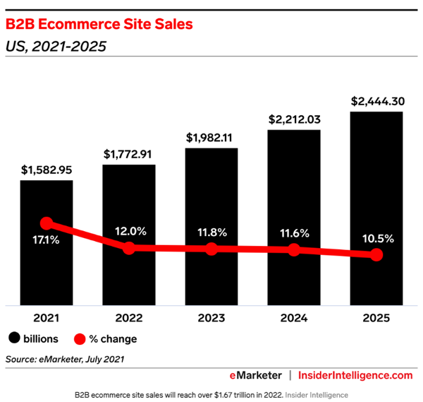
Another perspective
“RSA relies on the fact that the product of two prime numbers is computationally challenging to factor. It would take a classical computer trillions of years to break RSA encryption. A quantum computer with around 4,000 error-free qubits could defeat RSA in seconds.”
From https://www.insiderintelligence.com/insights/ecommerce-industry-statistics/
(Side note: IBM and Google plan on achieving a 1-million QC by 2030)
Notes:
In early QCs, qubits are noisy. The less noisy they become, the more efficient the calculations.

Slide 15
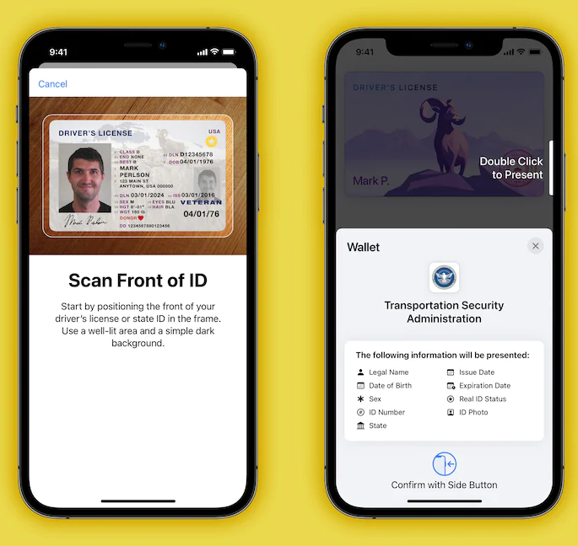
Digital identity
Digital passports and identity cards are protected w/ digital signatures
“More than 20 states have either considered, tested or already launched digital versions of driver’s licenses that live on smartphones. Colorado, Hawaii, Mississippi, Ohio and the territory of Puerto Rico have joined a handful of other states in signaling support for the feature.”
Image from https://www.washingtonpost.com/technology/2021/10/11/digital-drivers-license-mdl/

Slide 16
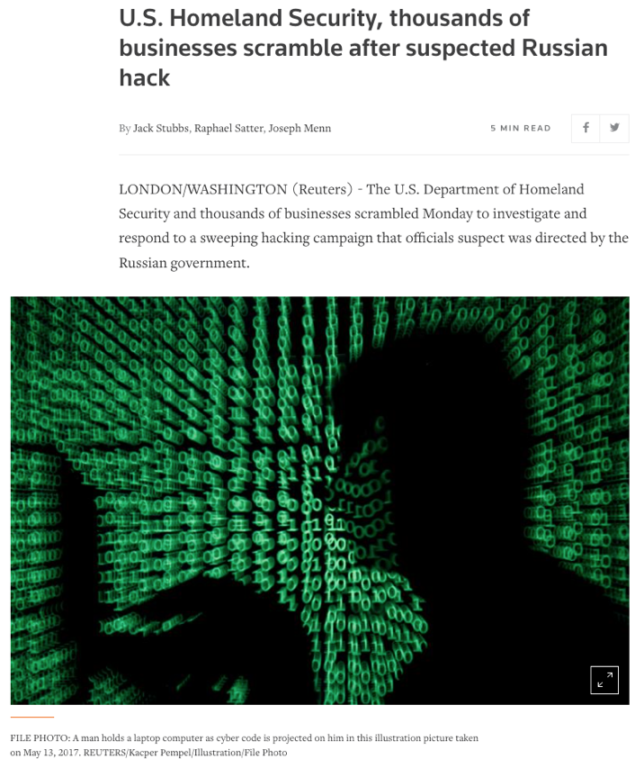
Data scraping
Encrypted data stolen from prior breaches is still at risk
Attackers are sitting on troves of encrypted data until quantum computing becomes more widely available
Article from https://www.reuters.com/article/global-cyber-idUSKBN28O1Z3
Notes:
25 years, remember?

Slide 17
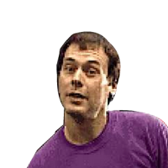
Post-quantum cryptography (PQC)
NIST project: PQC standardization (2016)
Round 1: 69 potential new methods
Round 2: 17 public key encryption / key establishment algos + 9 digital signature algos
Round 3: Shortlisted to 7 finalists + 8 alternates
NIST’s goal is to publish a draft standard by 2024
~5 years before Google and IBM’s 1-million QC goes live

Slide 18
UPDATE: We have some winners!
On July 5th, NIST announced the first standardized PCQ algorithms:
CRYSTALS-KYBER (Public-Key Encryption / Key Encapsulation Mechanism)
CRYSTALS-Dilithium (Digital Signatures)
Falcon (Digital Signatures)
SPHINCS+ (Digital Signatures)
PKE/KEM candidates for round 4 include:
BIKE
Classic McEliece
HQC
SIKE

Slide 19
Cybersecurity business opportunities
Companies | Focus
Quantum Dice & IDQuantique | Quantum random number generators
KETS Quantum Security & Toshiba | Quantum key distribution (enabling quantum-secure communications)
PQShield & Cipherloc | Post quantum cryptography (PQC)
Xanadu | Full-stack quantum machine learning
Notes:
Cipherloc Polymorphic Encryption Core (PEC) is symmetrically quantum-resistant

Slide 20
“Arguably, the key bottleneck in the quantum computing industry will be a lack of talent. While universities churn out computer science graduates at an accelerating pace, there is still too little being done to train the next generation of quantum computing professionals.”
US National Quantum Initiative Act (12/21/2018)
More at https://www.congress.gov/115/plaws/publ368/PLAW-115publ368.pdf
Notes:
Also, The worldwide market for quantum computing is predicted to be more than USD 10 billion by 2024, and USD 65 billion by 2030.
https://www.ibm.com/thought-leadership/institute-business-value/report/quantumsecurity
https://www.ibm.com/blogs/industries/quantum-computing-cybersecurity-risks-quantum-safe-cryptography/

Slide 21
Privacy-centric Web 3.0 technologies
Web 1.0 (static) -> Web 2.0 (dynamic) -> Web 3.0 (decentralized)
A few key Web 3.0 concepts & tech
Tokenization
Blockchain (more than just public ledgers)
Edge computing
We have an opportunity to rethink how we enable digital privacy.
Notes:
national identifier on the blockchain (permission, not confidentiality)

Slide 22
Strategic planning questions
Which enterprise data sets are most likely to be targeted by threat actors?
Which areas of your business operations could be impacted negatively by QC?
Which could be impacted positively (opportunities)?
What training (web3 + quantum) does your staff need?
Who will you partner with to address gaps?

Slide 23
Recommended actions
Government
Continue to advance quantum computing research
Continue to strengthen international cooperation
Assess quantum vulnerabilities
Pass legislation and implement policies designed to better recruit, develop, and retain cyber talent
Incentivize wide-scale adoption of new encryption standards
Convene experts across security, quantum computing, government, and private sector to establish how quantum computing’s impact on cybersecurity will affect the digital ecosystem
Business
Participate in cross-sectoral collaborations to address the impact of quantum computing on cybersecurity
Assess quantum vulnerabilities
Prepare for transition to quantum-resistant encryption
Enhance security of cloud computing
Support infrastructure investments
From https://www.belfercenter.org/publication/quantum-computing-and-cybersecurity
Notes:
Belfer Center for Science and International Affairs
Research institute in Cambridge, Massachusetts (Harvard)

Slide 24
If you only do three (3) things…
If you have 128-bit AES keys in play today, increase them to 256-bits
Quantum resistance
Explore emerging technologies like blockchain, passwordless authentication (FIDO2), and self-sovereign identity (SSI)
Rethink traditional approaches to authentication and authorization
Read ETSI’s “Migration strategies and recommendations to Quantum Safe schemes”
Spoiler alert: inventory compilation, then preparation of migration plan, then migration execution
https://www.etsi.org/deliver/etsi_tr/103600_103699/103619/01.01.01_60/tr_103619v010101p.pdf
Notes:
European Telecommunications Standards Institute

Slide 25
Further reading
How Quantum Computing Will Transform Cybersecurity
https://www.forbes.com/sites/forbestechcouncil/2021/01/04/how-quantum-computing-will-transform-cybersecurity/
Is Quantum Computing a Cybersecurity Threat?
https://www.americanscientist.org/article/is-quantum-computing-a-cybersecurity-threat
We need to build a quantum security coalition. Here's why
https://www.weforum.org/agenda/2020/08/we-need-to-build-a-quantum-security-coalition/

Slide 26
Further reading
Quantum Computing! See Google, IBM and Intel’s Labs (supercut)
https://www.youtube.com/watch?v=D04MXBzt-MA
Quantum computing and cybersecurity: How to capitalize on opportunities and sidestep risks
https://www.ibm.com/thought-leadership/institute-business-value/report/quantumsecurity

Slide 27
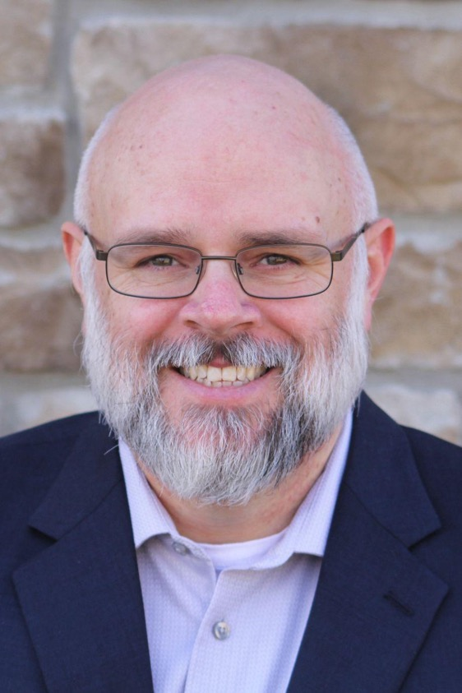
Jerod Brennen
https://www.linkedin.com/in/jerodbrennen
jerod@brennenconsulting.com

Slide 28
Thanks much!

